Slide 1
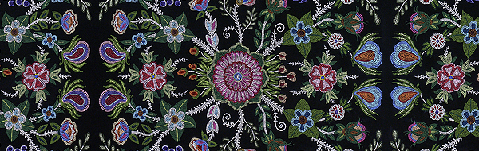
Statement of Acknowledgement of Traditional Land
“INFINITY” BY MÉTIS ARTIST CHRISTI BELCOURT
I (we) wish to acknowledge this land on which the University of Toronto operates. For thousands of years it has been the traditional land of the Huron-Wendat, the Seneca, and most recently, the Mississaugas of the Credit River. Today, this meeting place is still the home to many Indigenous people from across Turtle Island and we are grateful to have the opportunity to work on this land.
Notes:
I (we) wish to acknowledge this land on which the University of Toronto operates. For thousands of years it has been the traditional land of the Huron-Wendat, the Seneca, and most recently, the Mississaugas of the Credit River. Today, this meeting place is still the home to many Indigenous people from across Turtle Island and we are grateful to have the opportunity to work on this land.
“Acknowledging territory shows recognition of and respect for Aboriginal Peoples, which is key to reconciliation.” It is a statement of respect and a statement that provokes further thought and reflection. Purpose of acknowledgement also to acknowledge our position as newly arrived guests on this land, and to underscore our intent to highlight the impacts of settler colonialism on native peoples.

Slide 2
ABORIGINALS IN CANADA
A STUDY OF QUALITY OF LIFE INDICATORS FOR FIRST NATIONS, INUIT AND METIS PEOPLES
JOÃO PAULO CAMPOS MAIA PINTO
LUCIANA BERTHOLIM NASCIBEN
MAX LOUIS-JUSTE
ELIZABETH LOUISE SANTONATO
Notes:
We have taken as our subject the study of aboriginals in Canada…

Slide 3
AGENDA
Introduction & Problem Statement
Methods
Findings
Conclusions
Implications & Discussion

Slide 4
INTRODUCTION
Introduction & Problem Statement
Notes:
There is a huge and growing problem within the aboriginal populations of Canada. We know this because we see it across the country, in our cities, on our streets, and the news media is frequently reporting stories of boil water advisories on First Nations reserves, Prime Minister Trudeau campaigned on a series of promises for reconciliation with the First Nations, Inuit and Métis peoples of Canada, the Missing and Murdered Indigenous Women’s campaign received a lot of attention and has largely disappeared from the news although women continue to go missing or are found murdered in lakes and rivers across the country, we know that alcoholism and substance abuse is prevalent, a result of systemic abuse and suffering caused by the residential school system which removed children from their families by placing them in residential schools where they suffered physical, sexual and emotional abuses, punished for speaking their language or practicing their customs… yet today the First Nations peoples of Canada are beginning to thrive as the 7th generation is rising. A look at the Statistics Canada data reveals:

Slide 5
INTRODUCTION
The purpose of our study is to analyze the differences between the Aboriginal, and Non-Aboriginal, identity population in Canada in terms of specific quality of life indicators such as: access to health care services, perceived health status, frequency of diseases, and socioeconomic aspects (income, education, age structure).

Slide 6
CURRENT STATISTICS
In 2016, there were 1,673,785 Aboriginal people in Canada, accounting for 4.9% of the total population. This was up from 3.8% in 2006 and 2.8% in 1996.
Statistics Canada, 2016 Census of Population

Slide 7
CURRENT STATISTICS
Since 2006, the Aboriginal population has grown by 42.5%—more than four times the growth rate of the non-Aboriginal population over the same period.
Statistics Canada, 2016 Census of Population

Slide 8
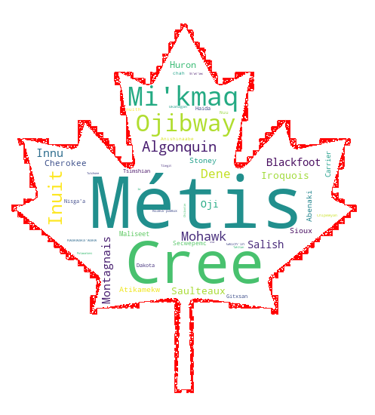
Questions and concerns
What does the future look like for aboriginal peoples in Canada?
What key quality of life indicators can we look to for analysis?
What dataset information is publicly available for study?
Who has jurisdiction over the areas where people live?
Who has jurisdiction over the data
Map of Aboriginal Ancestry survey responses
Notes:
Legacy of colonialism continues as communities are marginalized and segregated via reserves

Slide 9
RESEARCH QUESTIONS
What is the distribution of aboriginal population throughout the national provinces?
What is the proportion of aboriginal population on and off reserves
What is the income disparity
How do we compare the access to healthcare services (medical doctor for example) for both population?
Contact with a medical doctor in the past 12 months
Has a regular medical doctor
Health habits
Identify Variables
Current smoker, daily or occasional
Food Insecurity, moderate or severe
Fruit and vegetable consumption, 5 times or more per day
Chronic diseases
Diabetes
5 or more drinks on one occasion, at least once a month in the past year
Never had alcoholic drinks in the past 12 months
High blood pressure, heart disease or suffering from effects of stroke
One or more chronic conditions
Respiratory problems
Perceived health
Perceived health, very good or excellent
Perceived health, fair or poor
What are the difference in terms of age structure, income and education for all groups?
How do we compare Influenza immunization for both population?
Variables
Influenza immunization, less than one year ago

Slide 10
METHODS
On the Statcan API we needed data in two different levels, one in province level as a whole and two, for each aboriginal reserve. So, for each level of data we had to make two different calls API calls.
The parameters we used for these calls were:
Type = JSON
Lang = E (English)
Geos = CSD (municipalities) and PR (provinces)
Notes:
The first one, we used the 2016 Census geographies web data service to get a list with province names and the dguid code for each province for the province level data and the same two information + the reserve name for each reserve on the municipalities level data.

Slide 11
METHODS
The parameters we used for these calls were:
Type = JSON
Lang = E (English)
dguid = number we got in the first query
Topics:
Aboriginal peoples - used for the aboriginal and non-aboriginal people living in each province
Education - used for the comparison of education level between people living in Indian reserves and in the province as a whole
Income - used for the comparison of average income between people living in Indian reserves and in the province as a whole
Population - used for the comparison of age between males and females living in Indian reserves and in the province as a whole and for the population growth table and charts
Notes:
After that was done, with these two lists, we went to the 2016 Census Profile Web Data Service and made a for loop calling each dguid code of the list and appended the data we needed into a dataframe.

Slide 12
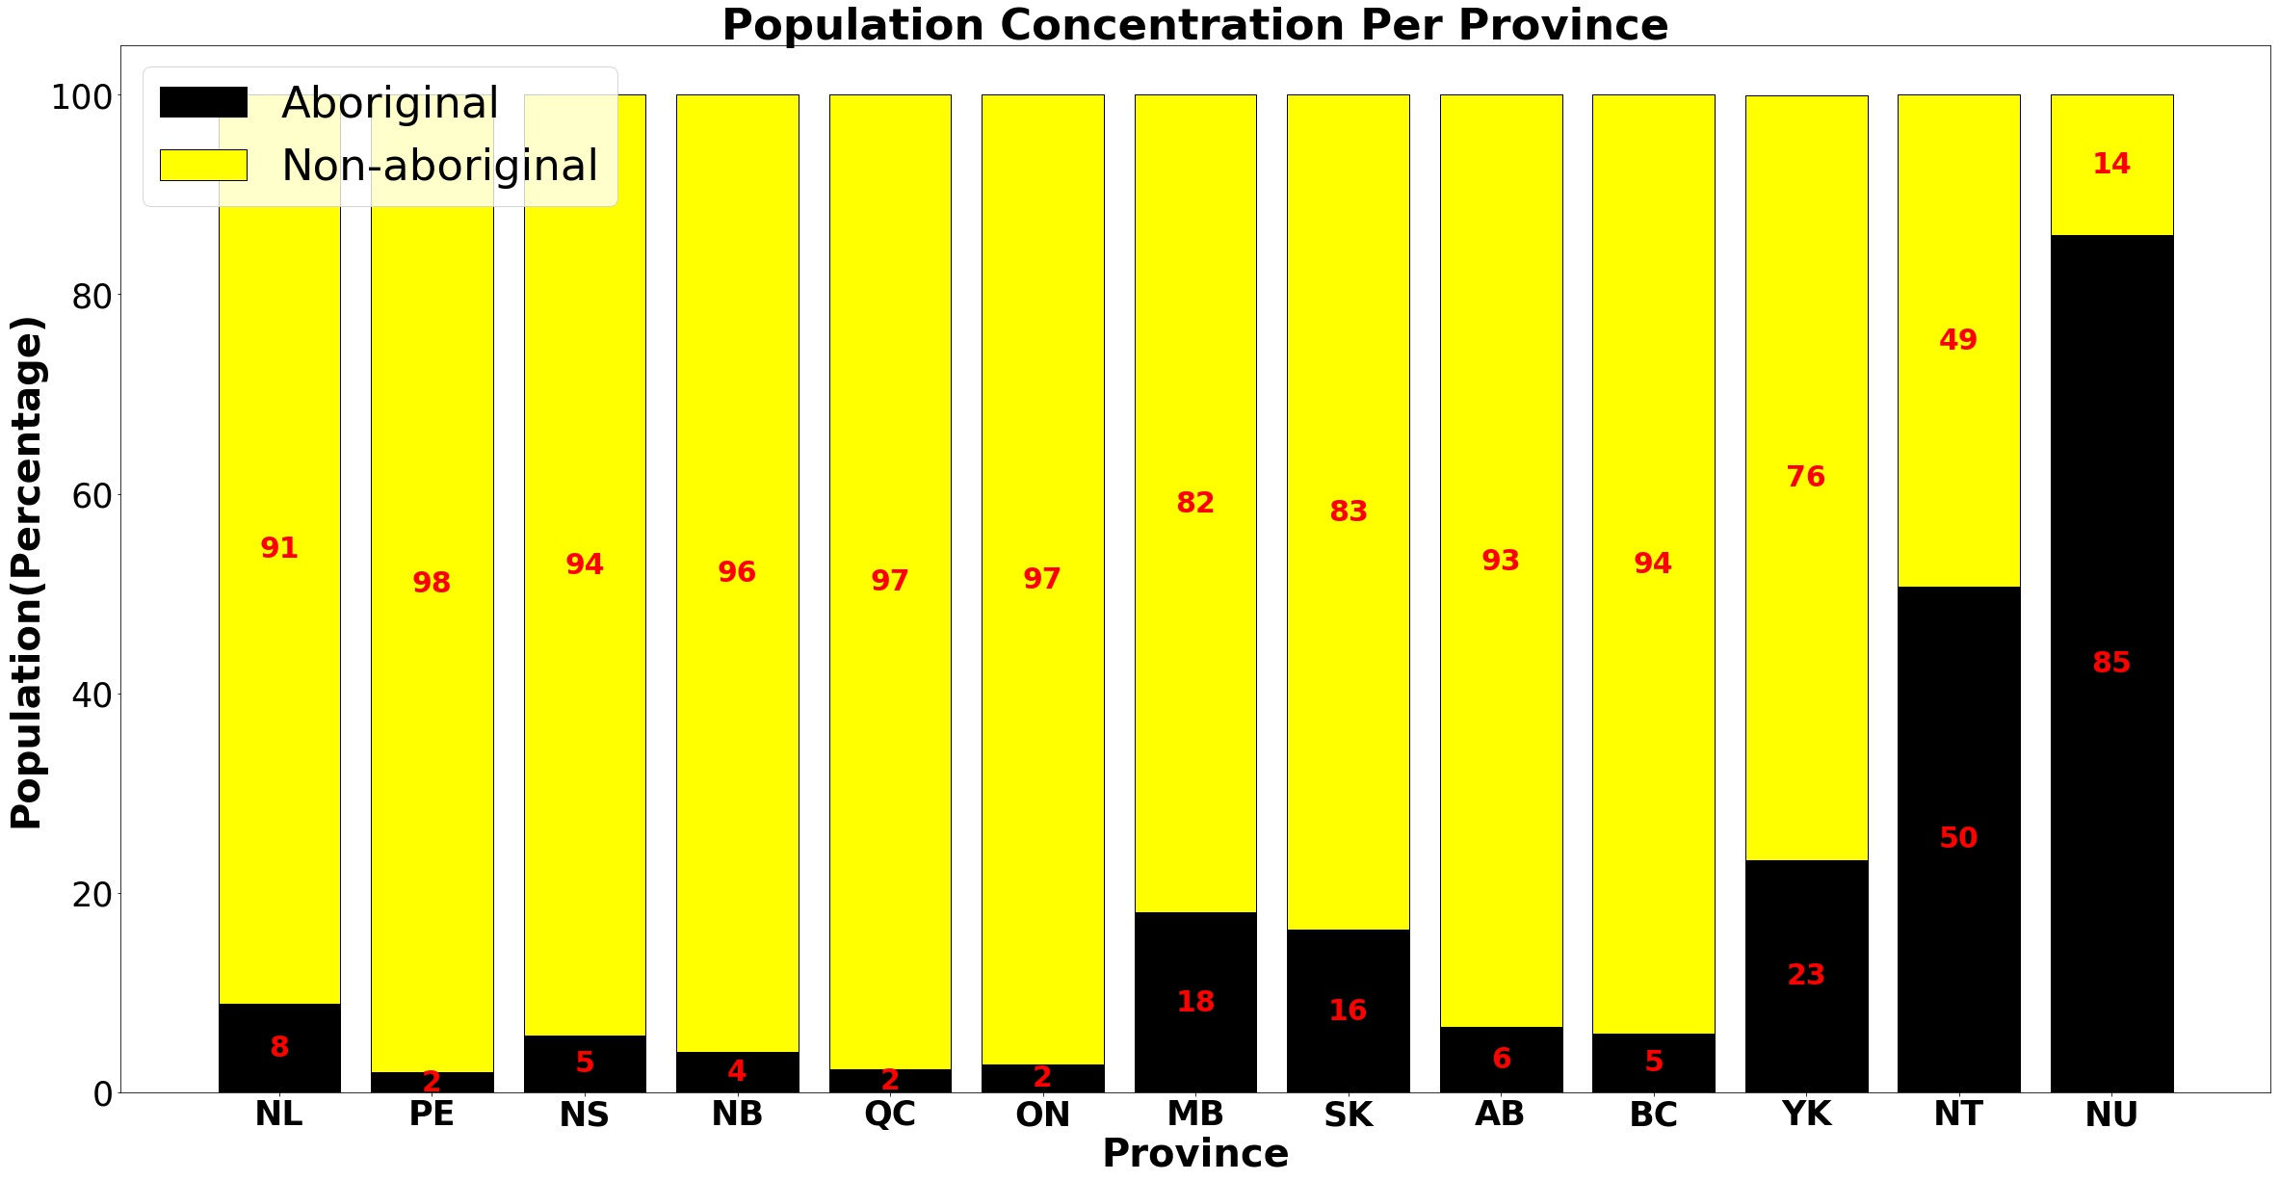
POPULATION

Slide 13
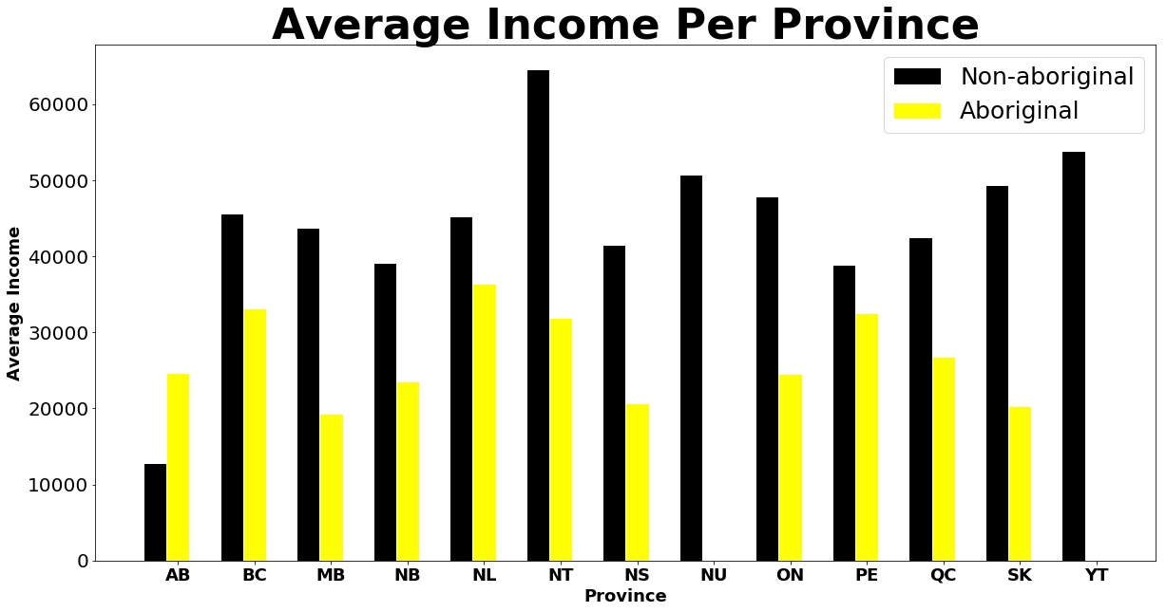
INCOME

Slide 14
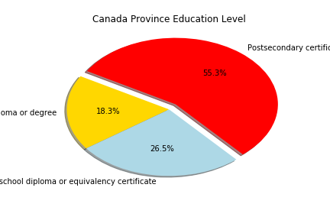
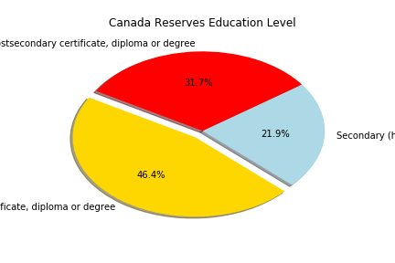
edUCATION
Notes:
- As expected, in the province level the majority of the population (around or above 50%) detain a higher level of education having obtained a postsecondary degree.
- In the aboriginal reserves, we see the opposite picture, being almost half of the population without a higher or secondary education certificate
- We can highlight the maritime provinces of Nova Scotia and New Brunswick where the aboriginal in reserves have an improved ratio of access to education, being only one third of its population without any certificate of higher or secondary education

Slide 15
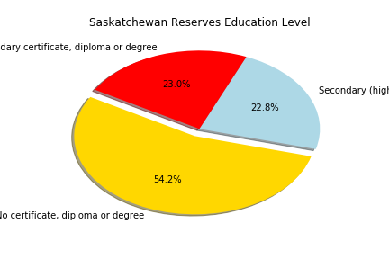
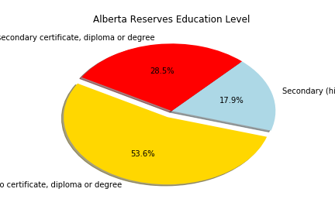
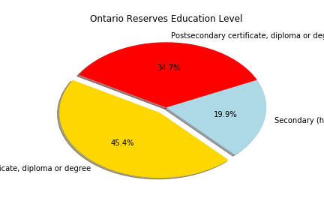
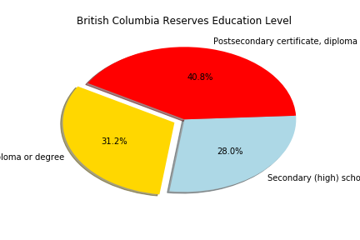
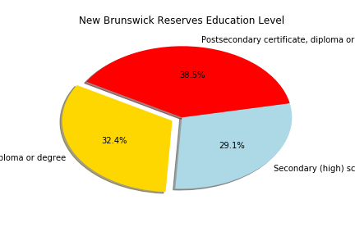
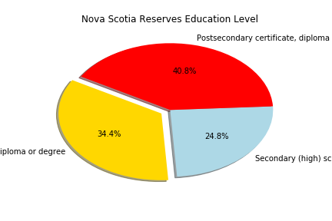
edUCATION
Notes:
- As expected, in the province level the majority of the population (around or above 50%) detain a higher level of education having obtained a postsecondary degree.
- In the aboriginal reserves, we see the opposite picture, being almost half of the population without a higher or secondary education certificate
- We can highlight the maritime provinces of Nova Scotia and New Brunswick where the aboriginal in reserves have an improved ratio of access to education, being only one third of its population without any certificate of higher or secondary education

Slide 16
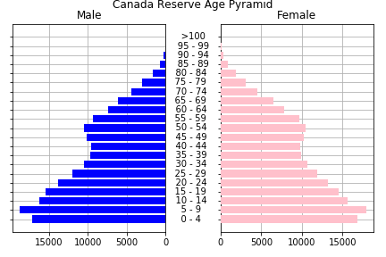
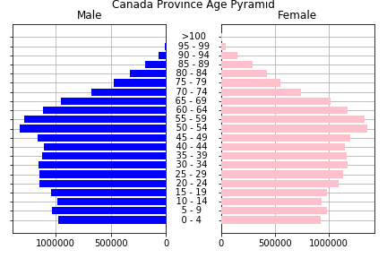
AGE DISTRIBUTION
Notes:
- The age pyramid for most Canadian provinces reflects the country’s developed nation characteristics where it becomes larger between the middle and the top of the chart. On the other hand, aboriginal reserves tend to have a large base in the pyramid with a much younger population.
- The outliers in this studies were BC’s indian reserves which also had an inverted pyramid, with more older people in its population. Nunavut reflected its majority aboriginal population in its province pyramid, being a large base one.

Slide 17
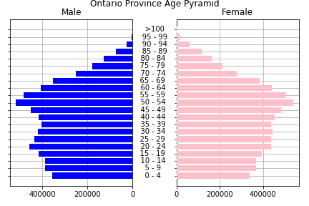
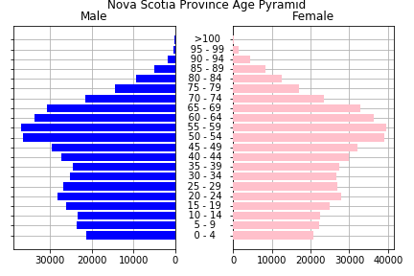
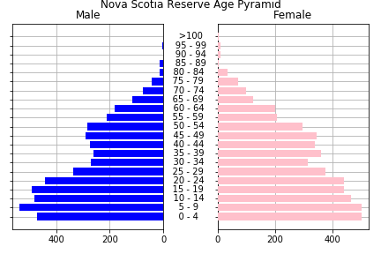
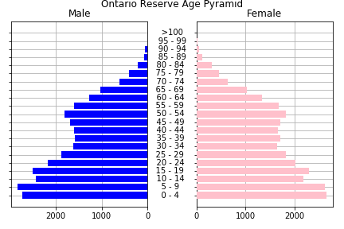
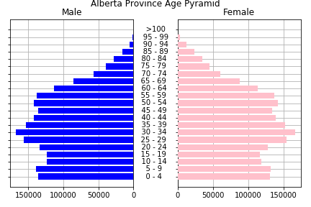
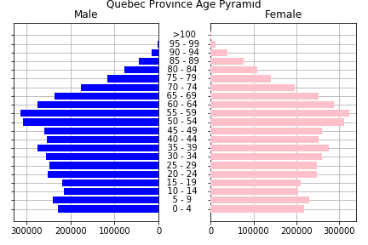
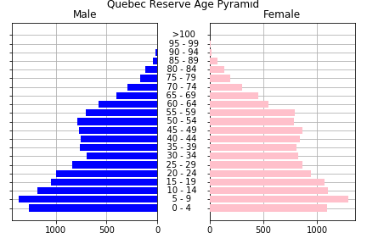
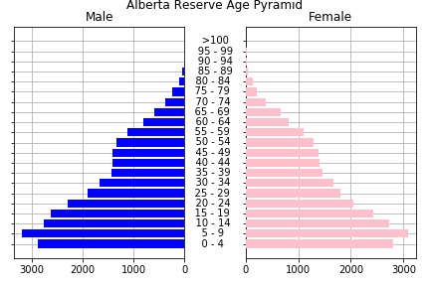
AGE DISTRIBUTION
Notes:
- The age pyramid for most Canadian provinces reflects the country’s developed nation characteristics where it becomes larger between the middle and the top of the chart. On the other hand, aboriginal reserves tend to have a large base in the pyramid with a much younger population.
- The outliers in this studies were BC’s indian reserves which also had an inverted pyramid, with more older people in its population. Nunavut reflected its majority aboriginal population in its province pyramid, being a large base one.

Slide 18
Community Well-Being (CWB) Index
The Community Well-Being (CWB) index is a means of examining the well-being of individual Canadian communities.
The index is calculated using four components:
Income (income per capita)
Education (number of community members with higher edication levels)
Housing (number of community members living in good house conditions)
Labour (employment rates)

Slide 19
Community Well-Being (CWB) Index
Questions:
What are the differences between First Nations and non-aboriginal communities across time at a province level
How the CWB index for non-aboriginal communities differs between province?

Slide 20
Community Well-Being (CWB) Index
Methods
Csv files were available for 1996, 2001, 2006 and 2011
Each csv file had the CWB index calculated per census subdivision
Csv files were cleaned and merged the files into a unique dataframe, using census subdivision as the index
Census subdivision’s code were splitted to show the province part of the code (first and second character), which I've used to group census subdivision per province
Each Census subdivision is classified as "First Nation communities" or "non-aboriginal communities“
I used groupby function to group the table by Province, and then type of community
Calculated the weighted average CWB for each province, for first nation and non-aboriginal communities

Slide 21
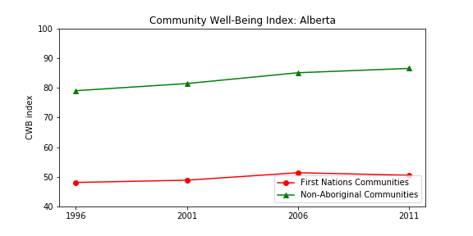
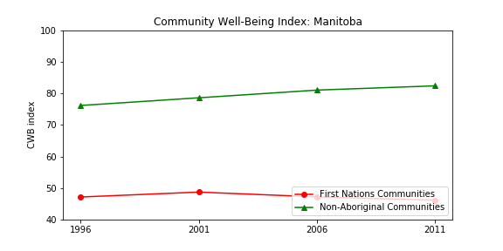
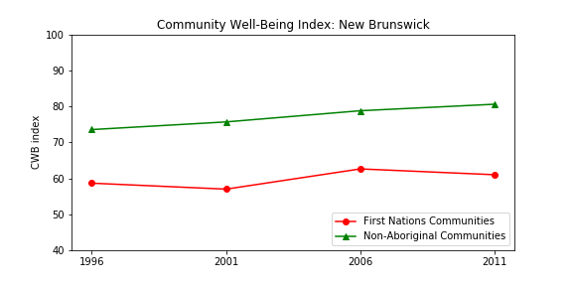
Increasing differences

Slide 22
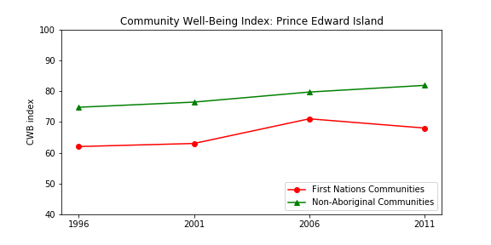
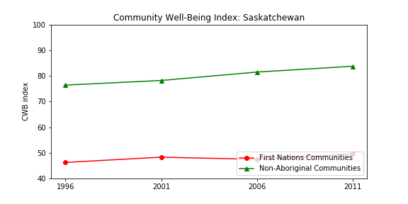
Increasing differences

Slide 23
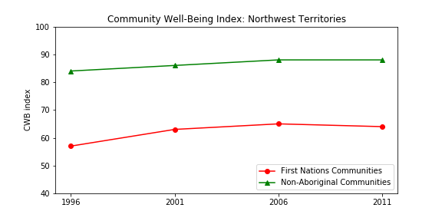
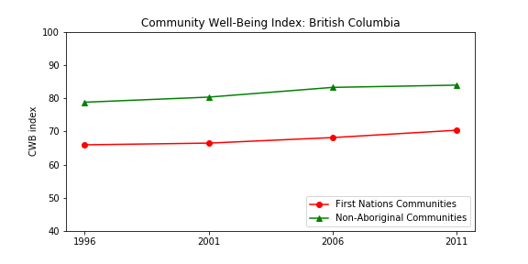
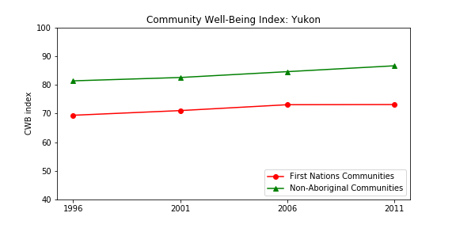
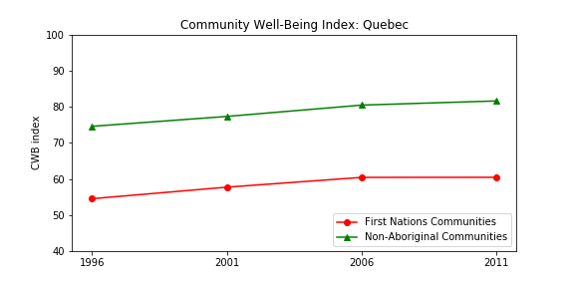
Differences are stable

Slide 24
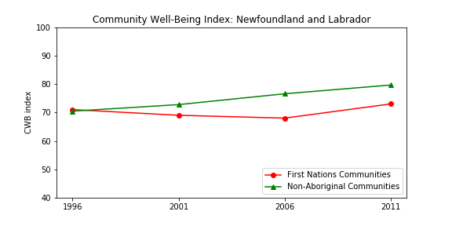
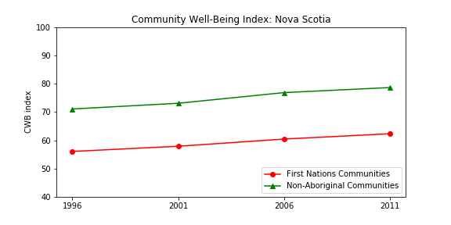
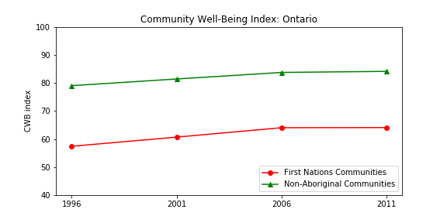
CWB indices are improving

Slide 25
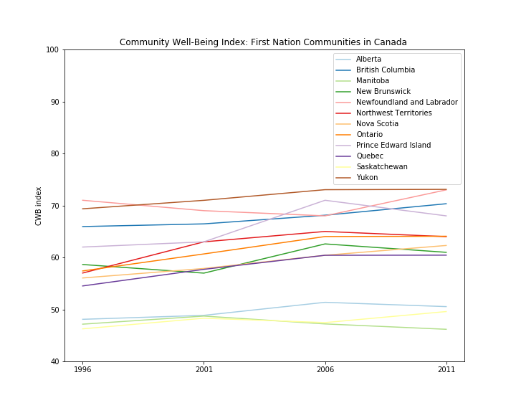
COMPARING FIRST NATIONS CWB INDEX SCORES OVER TIME
Yukon has the best CWB index for all provinces
Followed by Newfoundland and Labrador and British Columbia
Manitoba has the worst index
Second worst index was calculated for Saskatchewan

Slide 26
Health indicators: Heavy Drinking
As a result of a history of colonization, isolation, poverty and language barriers, abuse of substances — especially alcohol and solvents — is more common in First Nation Communities
What are the differences between First Nations and non-aboriginal population in terms of alcohol abuse?

Slide 27
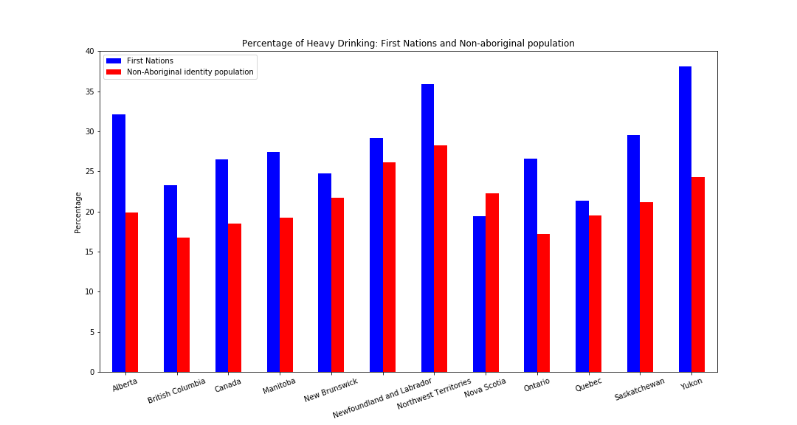
Health indicators: Heavy Drinking

Slide 28
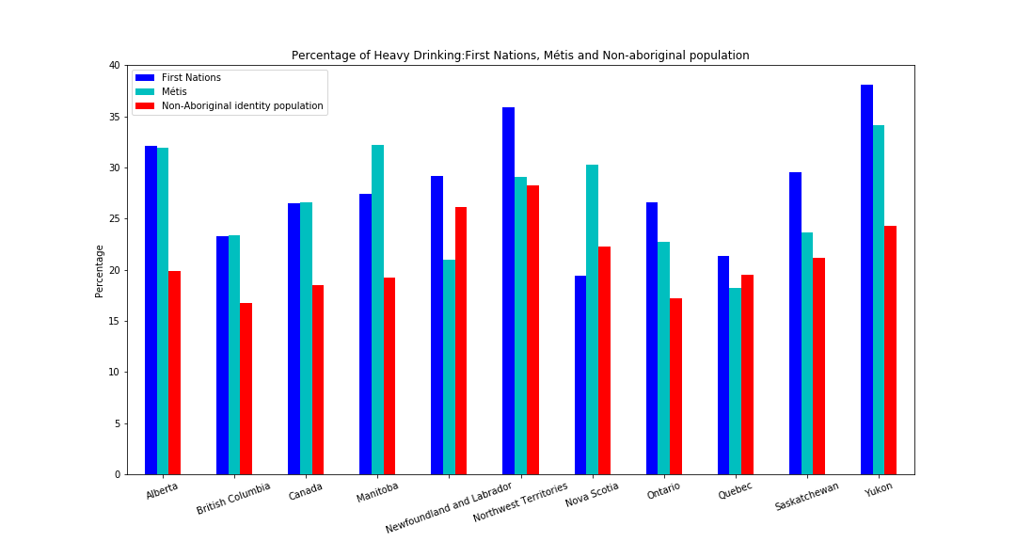
Health indicators: Heavy Drinking

Slide 29
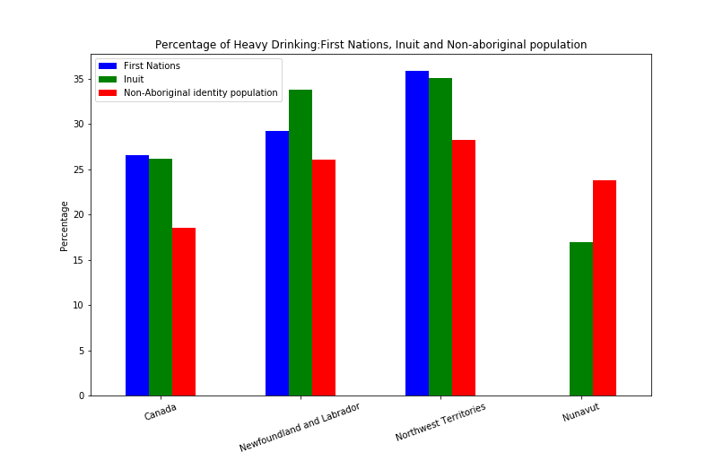
Health indicators: Heavy Drinking

Slide 30
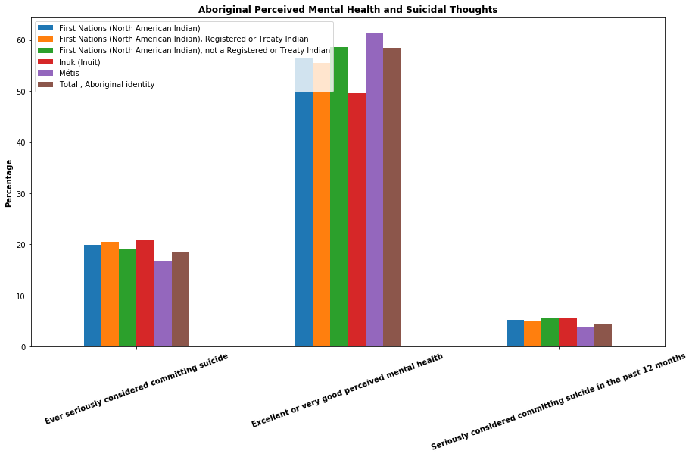
Health indicators: mental health and suicide

Slide 31
RESEARCH FINDINGS
Population Per Province
Population YOY increase
Population Age Per Province/Reserve
Education per Province/Reserve
Income Per Province/Reserve
Community Well-Being Index
Health
Access to Food
Perceived Mental and Suicidal Thoughts
Major limitations in access to data because of the structure and legacy of colonialism in Canada

Slide 32
LIMITATIONS
Health indicators are for aboriginal and non-aboriginal populations while all other data sets are for
Challenges of limited data, only api was census
Lacking data for some areas on reserves - Nunavut and Yukon
Coverage of all types of indigenous peoples
Issues of non-response leads to missing data
Working with sets prepared by Statistics Canada, cannot cross-reference
Limitations in structure and language over survey questions
We don’t have access to the data behind the work
A lot of data for reserves is not available
Notes:
The limitations on this dataset were the lack of data for reserves for both Nunavut and Yukon provinces.

